Slide 1

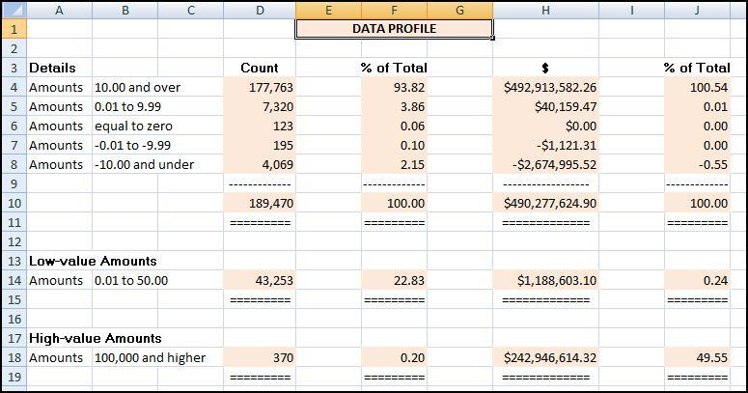
Chapter 4
Data profile
Data histogram
Periodic graph
Excel and Access steps
Prepared by:
Mark J. Nigrini
Copyright © 2012 by Mark J. Nigrini. All rights reserved.
Notes:
Pages 63 to 84.
Chapter discusses several high-level tests that are a useful starting point in any project.

Slide 2
data profile
Notes:
Pages 64 to 67.
Figure 4.1.
The above strata or categories are described as the (1) large positive numbers, (2) small positive numbers, (3) zeroes, (4) small negative numbers, and (5) large negative numbers. Depending on the data under investigation, you might want to add extra strata or categories.

Slide 3
data profile - findings
File completeness
High proportion of low-value invoices
Zero invoices
Number of credit memos
Negative amounts
Notes:
Pages 65 to 66.
The data profile won't tell a story to us. We need to look carefully at the numbers and together with an understanding of the data we should develop some insights. It often helps to review the data profile with someone that is closely connected to the data.

Slide 4
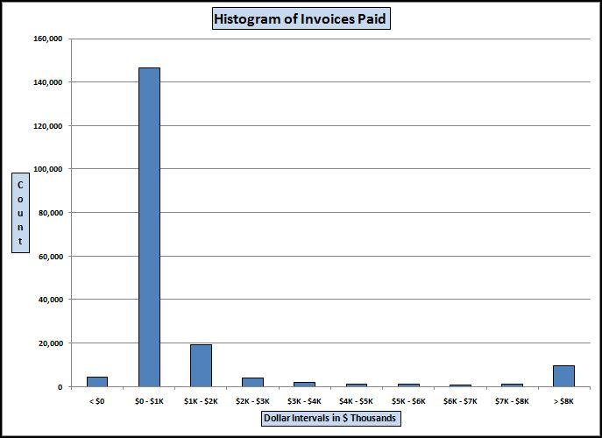
data histogram
Notes:
Pages 67 to 68.
Figure 4.2.
The histogram tells us something more about the properties of our data. We get to know how many small numbers there are, how many in-between numbers there are, and how many large numbers there are. The data histogram is shown graphically, whereas the data profile is a numeric table.

Slide 5
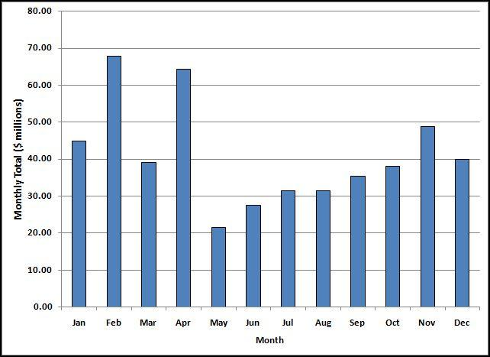
periodic graph
Notes:
Page 69.
Figure 4.3.
This test divides the data into time period and shows the total per time period on a graph with time shown on the x-axis. This is useful for a better understanding of the data, and also to detect large anomalies.

Slide 6
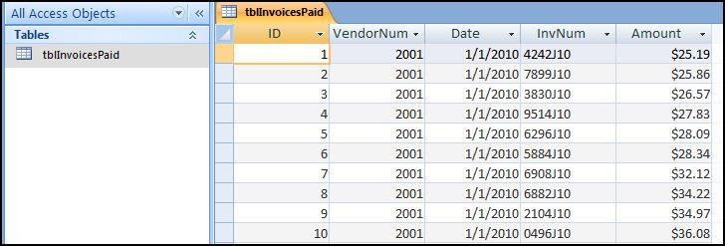
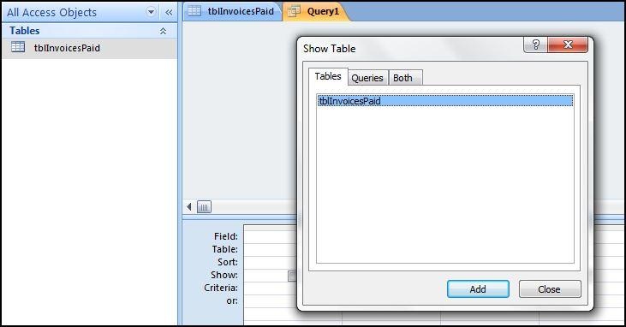
data profile: access
Notes:
Pages 70 to 74.
Figures 4.4 and 4.6.
The first query dialog box is shown in Figure 4.6. This dialog box is used to select the table or tables, and some past query or queries that will be used in the current query. Click Add and then Close to add the tblInvoicesPaid table to the top pane of the Query window.

Slide 7
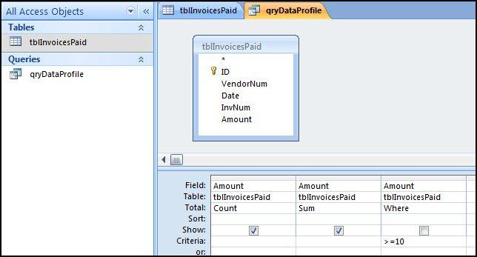
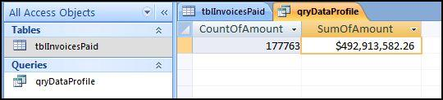
data profile: access
Notes:
Pages 70 to 74.
Figures 4.8 and 4.9.
The completed query grid is shown in Figure 4.8. The query is run by clicking the Run button. This button is found at Design→Results→Run. The Run button has a large red exclamation point that makes it easy to see. The query results are shown in Figure 4.9.

Slide 8
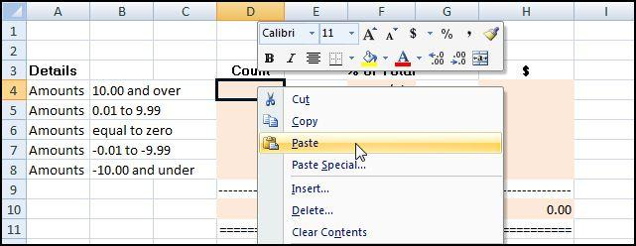
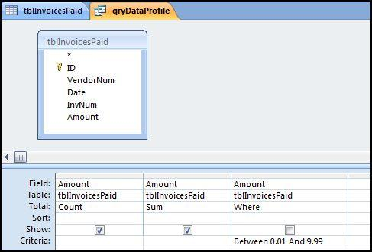
data profile: access
Notes:
Pages 70 to 74.
Figures 4.10 and 4.11.
The step used to paste the number calculated in Access into Excel is shown in Figure 4.10. The Copy and Paste routine must be done for each of the 14 calculated values in the data profile (two calculated values per query).
The criterion for the second stratum in the data profile is shown in Figure 4.11. In Access "Between 0.01 And 9.99" means all numbers in the interval including 0.01 and 9.99.

Slide 9
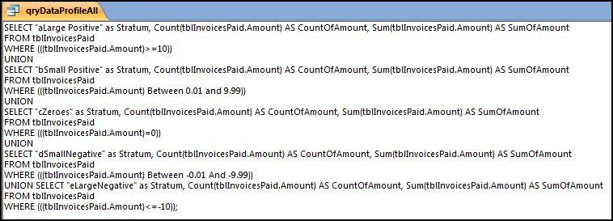
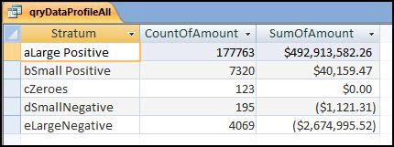
data profile: union query
Notes:
Pages 74 to 77.
Figures 4.14 and 4.15.
In this section all seven queries will be combined to form one data profile query.
With a union query we'll run the seven strata queries at the same time by changing the criteria. For example, the criterion for the first stratum is ">=10," and the criterion for the second stratum is "Between 0.01 and 9.99." To stack the queries on top of one another we need to (1) delete the semi-colon and move it to the end of the query, (2) insert the word "Union" (without the quotation marks and preferably in capital letters) between each query, and (3) update the criteria.

Slide 10
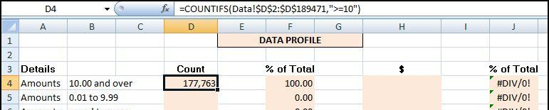
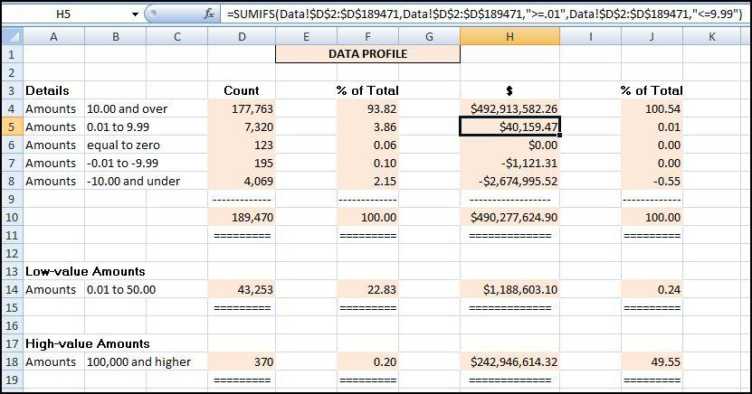
data profile: excel
Notes:
Pages 77 to 79.
Figures 4.17 and 4.18.
Excel works well when the original data is in an Excel file and when the number of records is less than the maximum row count in Excel (1,048,576 rows)

Slide 11
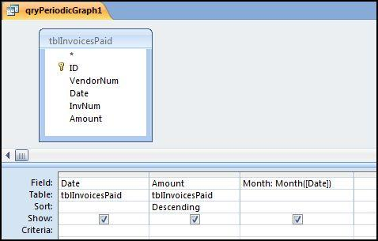
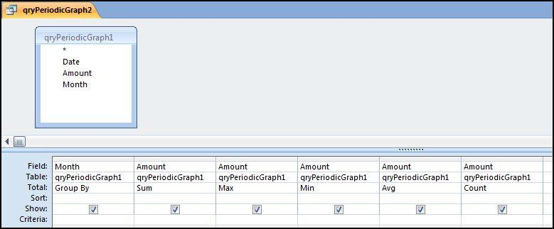
periodic graph: access
Notes:
Pages 79 to 81.
Figures 4.19 and 4.20.
The first query calculates the month from the date and the second query sums the dollars per month. We need to calculate the month because the totals are monthly totals. The query to calculate the month from the date is shown in Figure 4-19.

Slide 12
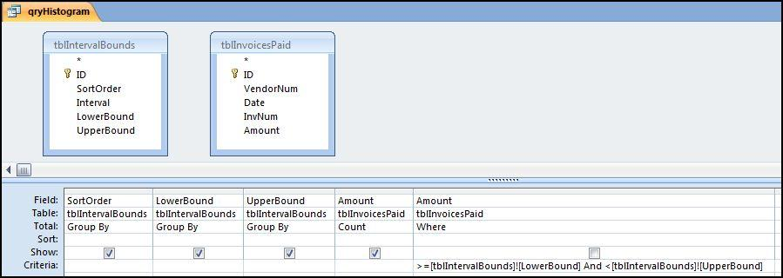
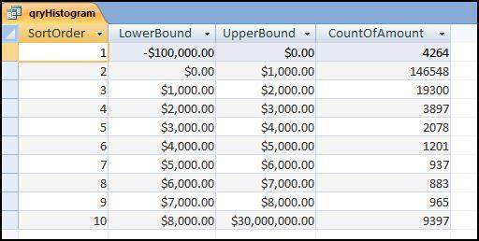
histogram: access
Notes:
Pages 81 to 82.
Figures 4.23 and 4.24.

Slide 13
summary
Three high-level tests, to give a data overview
Data profile:
Small and large positive and negative numbers
Shows count and sum for each stratum
Periodic graph: Monthly totals
Histogram: Shows counts in the intervals
Tests can be done in Access and Excel
Could be value-added activities done by the external auditors
Notes:
Pages 83 to 84, and a review of the main points.

